Slide 1



STRINGS IN PYTHON

Slide 2

Day Plan
String Indexing
String Methods
String Slicing
Task for the week
Access values in a string
Built in methods you can use on strings
Get a “slice” of a string
mEmEiFy TeXt

Slide 3

01
String Indexing
Learn how to access values in a string

Slide 4


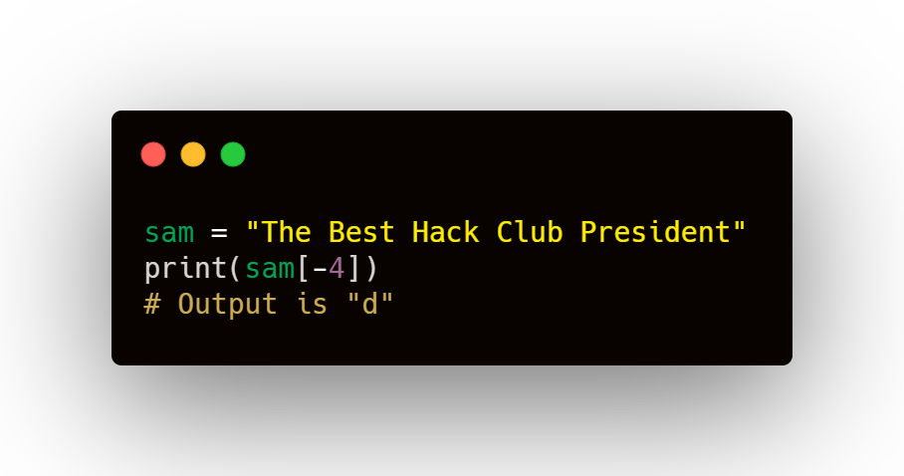

String Indexing
You can also use negative numbers to index backwards
You can access specific characters of a string by using square brackets around the specific character.
Starts at -1
Remember: in coding all things start at 0

Slide 5
02
String Slicing
Learn how to spilt a string into a specific part

Slide 6
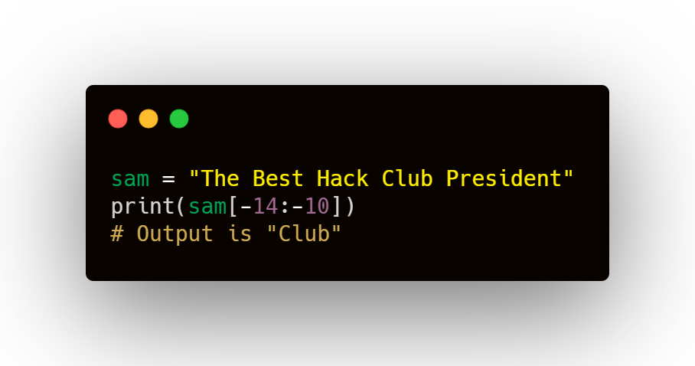
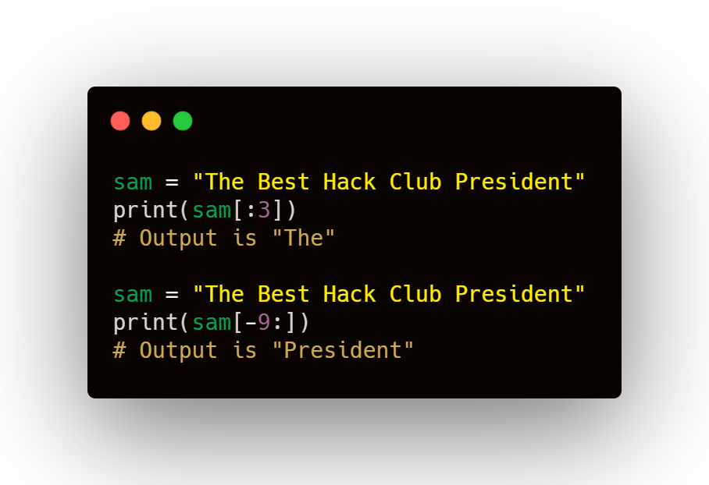

String Slicing
This can also be done with the negative numbers
You can break apart a string an collect a specific part by placing square brackets around the edge characters you want, seperated by a colon.
First # is lower
To do from the start or to the end of something

Slide 7
03
String Methods
Learn a few useful built-in python string methods

Slide 8
Some Methods
string.casefold()
This is built-in so no imports are necessary
convert the string to lowercase
string.lower()
convert string to lowercase
string.isspace()
t/f to whether a string is entirely whitespace “ “
string.upper()
string.isupper()
convert string to uppercase
t/f to whether a string is entirely in uppercase
Python String Methods (w3schools.com)

Slide 9
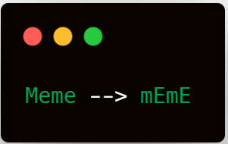
04
Task for the week
RULES
Use what you’ve learned to “memeify” a 4 letter word provided by the user
User input can be longer, only first 4 characters need to be “memefied”
First character must be lowercase the next uppercase, this pattern repeats

Slide 10


GOOD LUCK
Reach out to the trainers on discord if you need any help

